Slide 1
Tips for “First Responder” Counsel: Navigating the Early Stages of a Government Investigation
Glenn P. Hendrix
Arnall Golden Gregory LLP

Slide 2
“First Responder” Situations in Government Investigations
The company learns that:
Government agents are contacting current or former employees.
OIG subpoena, DOJ civil investigative demand (CID), etc. has been served.
Government agents are executing a search warrant or raid.

Slide 3
Government Agent Contacts with Company Employees

Slide 4
Government Agent Interviews of Current or Former Employees
Most likely to occur through an unannounced, evening visit to an employee’s home (“knock and talk”), but may also occur by phone.
May also be attempted on company premises while serving a subpoena or executing a search warrant, or by ZPIC investigators.

Slide 5
The Perils of Unfettered Government Agent Contact with Employees
Upon being contacted by agents with badges (and often guns), employees will feel intimidated, anxious and excited.
They may tell the agents what they believe they want to hear, even if this presents an inaccurate picture of the company.
They may also inadvertently provide privileged information or hand over corporate documents.

Slide 6
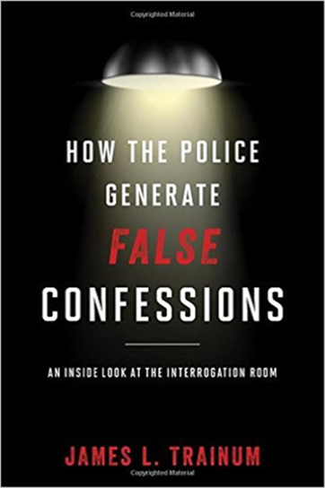
The False Confession Phenomenon
A substantial body of research shows that many individuals – especially the highly suggestible or compliant – will
respond to intense interrogation by
telling law enforcement agents what they believe the agents want to hear.
In extreme cases,
they may even
falsely confess to
crimes they didn’t
commit.

Slide 7
Can Federal Agents Interview Employees Without the Company’s Knowledge

Slide 8
Rule 4.2 “No-Contact” Rule
If current employees are being contacted, the company should consider invoking the “no-contact rule” adapted by most states from ABA Model Rule 4.2:
“In representing a client, a lawyer shall not communicate about the subject of the representation with a person the lawyer knows to be represented by another lawyer in the matter, unless the lawyer has the consent of the other lawyer or is authorized to do so by law or a court order.”

Slide 9
Can Agents Interview Corporate Employees Without the Company’s Knowledge?
Rule 4.2, Comment 7:
The rule prohibits communications with a “constituent” of a represented organization (including employees) who
supervises, directs or regularly consults with the organization’s lawyer concerning the matter, or
has authority to obligate the organization with respect to the matter, or
whose act or omission in connection with the matter may be imputed to the organization for purposes of civil or criminal liability.

Slide 10
Former Employees
The vast majority of reported decisions hold that Rule 4.2 does not prohibit or restrict contact with former constituents.
But see Restatement (Third) of the Law Governing Lawyers, §100, Comment g (stating that in certain unusual circumstances, such as a former employee consulting regularly with an organization's lawyer about the matter, a former employee may be covered by the no-contact rule).
See also Public Serv. Elec. & Gas Co. v. Assoc. Elec. & Gas Ins. Serv. Ltd., 745 F. Supp. 1037 (D.N.J. 1990); Porter v. Arco Metals Co., 642 F. Supp. 1116 (D. Mont. 1986); Amarin Plastics Inc. v. Maryland Cup Corp., 116 F.R.D. 36 (D. Mass. 1987).

Slide 11
Can Agents Interview Corporate Employees Without the Company’s Knowledge?
McDade-Murtha Amendment, 28 U.S.C. § 530B (1998).
Requires federal prosecutors to follow state and federal rules of professional responsibility in effect in the states where they conduct their activities and in which they are licensed to practice.
See also 28 C.F.R. § 77.
The rule applies to DOJ lawyer-directed agents.
See ABA Opinion 95-396.

Slide 12
Communications “Authorized by Law”
Rule 4.2 authorized-by-law exception: “[A] lawyer shall not communicate … with a person the lawyer knows to be represented by another lawyer in the matter, unless the lawyer has the consent of the other lawyer or is authorized to do so by law or a court order”).
When is a communication with a government agent “authorized by law”?
Does “authorized by law” mean specifically permitted or merely not prohibited?

Slide 13
Can Agents Interview Corporate Employees Without the Company’s Knowledge?
Rule 4.2 does not define “authorized by law.”
Comment 5 states:
“Communications authorized by law may also include investigative activities of lawyers representing governmental entities, directly or through investigative agents, prior to the commencement of criminal or civil enforcement proceedings. When communicating with the accused in a criminal matter, a government lawyer must comply with this Rule in addition to honoring the constitutional rights of the accused. The fact that a communication does not violate a state or federal constitutional right is insufficient to establish that the communication is permissible under this Rule.”

Slide 14
Can Agents Interview Corporate Employees Without the Company’s Knowledge?
ABA rejected amendments to Rule 4.2 in 2002 that would have authorized communications by government lawyer-directed agents prior to formal law enforcement proceedings.
Nevertheless, a number of courts reach the same result by interpreting the no-contact rule to be co-extensive with the Sixth Amendment’s right to counsel.

Slide 15
Bottom Line
Bottom line:
Necessary to research state by state.
Depending on the state and district, federal prosecutors will generally refrain from or cease contacting current employees if the company’s counsel object.

Slide 16
Advising Employees Who Have Been Or May Be Contacted By Agents

Slide 17
Advice To Employees Regarding Contacts by Government Agents
Advise employees to:
Ask for the agent’s name and request to see a badge or credentials.
Get a business card or make photocopies.
Ask the agent about the purpose of the visit.
Be respectful and polite, and create a cooperative atmosphere, BUT also understand their rights.
They are not obligated to consent to an interview with a government agent.
They may agree to be interviewed or they may decline to be interviewed.

Slide 18
Advice For Employees Regarding Contacts by Government Agents
They may also ask the agents to postpone or schedule the interview for a time that is more convenient for them.
If they agree to an interview, they may terminate it at any time.
If they agree to an interview, they should consider each question carefully.
If they disagree in any way with the premise or assumptions underlying the agent’s questions, they should say so.

Slide 19
Advice For Employees Regarding Contacts by Government Agents
If the employee agrees to an interview, they should know that a record may be made.
They do not have to sign any statement or affidavit.
If they choose to sign a statement or affidavit, they should ask before they sign for a copy.

Slide 20
Advice For Employees Regarding Contacts by Government Agents
If they wish to consult an attorney before being interviewed, they may tell the agents that they want to cooperate, but that they want to speak to an attorney first.
NOTE: Companies often retain “pool” counsel for groups of employees.

Slide 21
Advice For Employees Regarding Contacts by Government Agents
The agents may advise the employee that if they do not agree to an interview, they will be subpoenaed later to testify.
But while they may in fact receive a subpoena in the future, submitting to an interview now will not necessarily preclude a subpoena later.
The agents may advise the employee not to discuss the interview or their visit with anyone else.
The employee has the right to disclose or not disclose the interview.

Slide 22
Contacts by Government Agents: Summary of Key Points
The company cannot bar employees from speaking with agents, but can advise that they have the right to speak to the agent or not.
The company can ask (but not require) employees to notify company counsel if they are contacted.
Employees in a supervisory position must not advise other employees against speaking with the government. This may be interpreted as obstruction.
Emphasize that the employee must:
Always tell the truth.
NOT destroy, erase, or alter documents at any time, before or after agents try to talk to them.

Slide 23
Consider Advising Employees in Writing
Upon getting wind of an investigation, the company should consider providing written advice to employees along these lines on how to handle being contacted by a government agent.
A carefully crafted written memorandum on the subject may help prevent any misapprehension by the government as to the advice given (thus avoiding obstruction allegations).

Slide 24
Responding to OIG Subpoenas, DOJ CIDs and Similar Requests

Slide 25
Means of Federal Law Enforcement Access to Records
OIG subpoena, 5 U.S.C. Appendix 3, § 6(a).
DOJ HIPAA subpoena, 18 U.S.C. § 3486 – can be used in either civil or criminal health care fraud investigations.
DOJ Civil Investigative Demand (CID), 31 U.S.C. § 3733, for use in civil FCA investigations.
Grand jury subpoena, for criminal investigations.
Search warrant, for criminal investigations.
OIG informal request for records in lieu of a subpoena.
OIG demand for immediate access to records, 42 U.S.C. § 1320a-7(b)(12), which usually involves 24-hour notice of a visit to obtain production. Rarely used.

Slide 26
Increasing DOJ Focus on Emails and Texts
Government investigations are increasingly built on emails and text messages, with clinical records and other evidence often almost an afterthought.

Slide 27
Emails: A Government Investigator’s Best Friend
Lack of formality
Careless banter between employees
Lack of context and nuance
Easy to forward
Hard to delete (and even when clients believe an email’s been deleted, it may still exist somewhere)
Overwhelming volumes lead to overproduction

Slide 28
The Centrality of Email Evidence: Life Care as an Example
DOJ alleged in a general way that LCCA billed for RU-level therapy that “sometimes jeopardized the health of Medicare patients who were imminently terminal, fatigued, sick, or otherwise medically unstable.”
Yet although the government subpoenaed 360 medical records from LCCA, the DOJ’s 49-page complaint cited only a single specific instance of alleged harm to a patient.
The bulk of the allegations were based not on clinical findings, but rather on internal emails.

Slide 29
First Steps in Responding to Notice of an Investigation
Retain outside counsel
Implement a legal hold
Provide notice to insurers

Slide 30
Preservation Obligations
Both client and counsel have an affirmative obligation to:
Impose a written legal hold
Ensure all sources of relevant information are identified and made subject to the hold
Interview the key players
Ensure that custodians understand their preservation obligations

Slide 31
Preservation Obligations
Define the scope of the legal hold: what people and what systems?
Get with IT: stop automatic data deletion, preserve backups as needed, set email to “legal hold”
Don’t let the perfect be the enemy of the good—implement quickly and revise if needed
An ongoing obligation: remember to tweak the hold as new information comes to light

Slide 32
Preservation Obligations
The stakes are higher for preservation in a government investigation—failures can lead to an obstruction of justice allegation
Don’t go it alone—make sure your team has the law and the technology of ediscovery covered. It’s become a speciality, so don’t rely on generalists.

Slide 33
Initial Contact with the Government Attorney
Determine the identity of the government attorney and seek to establish a cooperative and cordial relationship.
Attempt to obtain as much information as possible regarding:
The type of enforcement contemplated (e.g., administrative, civil, criminal).
The specific conduct under investigation.
The government's theory or theories of what was done inappropriately.
How and why the investigation commenced.
But the government lawyer is likely to be tight-lipped at the outset. Repeated contact will yield further information.

Slide 34
Negotiating the Scope of the Production
There is almost always room to negotiate the scope and timing of production.
Establish the government’s priorities.
Rolling production
Open-ended productions
Instead of drawing a line in the sand over particular items in the subpoena, kick the can down the road, with the government reserving its rights to obtain those documents later.
Negotiating the scope or sequence of production provides insights regarding focus of the investigation.
Open a conversation about search terms/predictive coding, clawback agreements, etc. for ESI.

Slide 35
Negotiating Scope: Not a Level Playing Field
Hard-nosed litigation tactics generally are not helpful in the early stages of an investigation.
Government agencies can conduct fishing expeditions, including investigations merely on suspicion of violations or to assure themselves that the law is being followed.
U.S. Dept of Ed. v. NCAA (S.D. Ind. 2006); Inspector General v. Banner Plumbing Supply Co. (N.D. Ill. 1998) (“an IG’s investigative authority is broad and may be predicated solely on a suspicion of illegality”).
“As long as the information and materials requested touches a matter under investigation, the material and information requested is relevant.”
Inspector General v. St. Nicholas Apartments (C.D. Ill. 1996).

Slide 36
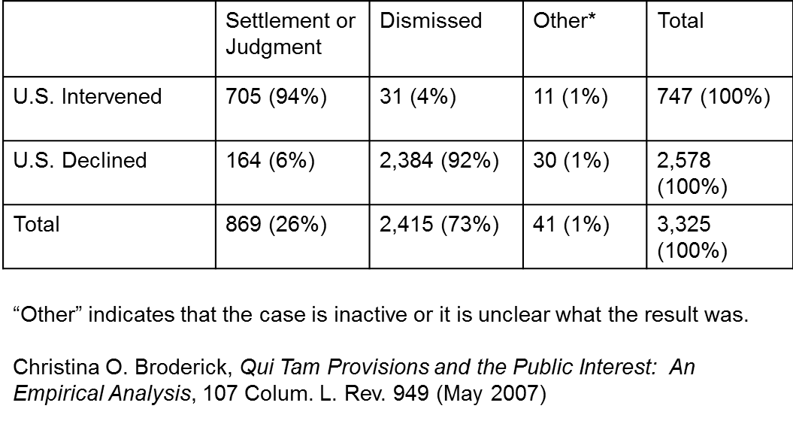
And You Do Want the DOJ to Like Your Client …
If the DOJ elects to pursue an FCA action against a company, in only 6% of cases does the matter end without any payment by that company.

Slide 37
Preserve Your Objections
Nevertheless, it is important to preserve objections.
4-part test for enforcement of administrative subpoenas: (1) the inquiry must be within the authority of the agency; (2) the demand for information must not be too indefinite; (3) the information sought must be reasonably relevant to the inquiry; (4) the information must not already be in the government’s possession.
U.S. v. Powell, 379 U.S. 48, 58 (1964).
In addition, the demand must not be unduly broad or burdensome.
U.S. v. Westinghouse Elec. Corp., 788 F.2d 164, 166 (3d Cir. 1986).

Slide 38
Preserve Your Objections, But Choose Your Battles Wisely
“[S]ubpoenas impacting an entity’s business dramatically may still be permissible if the agency is not exceeding the scope of its authority.”
U.S. Dept of Ed. v. NCAA (S.D. Ind. 2006).
“A subpoena will not be enforced if the demand is excessively burdensome, that is, if compliance would threaten the normal operation of a respondent’s business.”
“A subpoenaed party will always be forced to endure some inconveniences and burdens when complying with a subpoena, but these inconveniences and burdens are necessary to the furtherance of a Government agency’s legitimate inquiry and is in the public’s best interest.”
Inspector General v. St. Nicholas Apartments (C.D. Ill. 1996).

Slide 39
Request Confidentiality for Documents
Request that the company’s documents be afforded confidential treatment, in accordance with applicable state and federal law, and the government will make all future productions with the understanding that the documents being produced are exempt from disclosure under FOIA, 5 U.S.C. § 552(b).
Request that the company be given 10 days prior written notice before the government discloses any such confidential documents and request that the government not disclose the company’s confidential business, financial, proprietary, or patient information without the company’s prior written consent.

Slide 40
Search Warrants

Slide 41
Execution of a Search Warrant: Initial Response
The agents should produce the search warrant before entering.
The facility should notify supervisor or designated contact/counsel immediately.
An employee may request that the agents not start the search until counsel arrives, but if the request is rejected, they must not interfere.

Slide 42
Execution of a Search Warrant: Initial Response
If the search begins before counsel arrives, a senior employee should request:
the name and phone number of the government lawyer overseeing the investigation,
a copy of the search warrant, and
the application to the court and accompanying affidavit.
Non-essential employees should be sent home.

Slide 43
During the Search
Once the search begins, employees must not interfere with the agents or prevent them from accessing items listed in the search warrant.
Rule #1: Except as indicated below, stay out of the way!
Agents may attempt to interview employees during the course of the search. The rules previously discussed apply.
Counsel or a senior employee should request at the outset of the search that all requests to speak to employees be funneled through them.

Slide 44
During the Search
Although employees should be polite and cooperative, they should make clear that they do not consent to:
the search,
an expansion of the search beyond the areas specified in the search warrant, or
seizure of documents outside the scope of the warrant.
Employees should object to the search of privileged documents, to the extent they can identify them.
At a minimum, employees should request that privileged documents be segregated from other seized or copied documents and be so marked.

Slide 45
During the Search
The agents may seize only what’s listed in the warrant and search only those areas listed in the warrant.
To the extent possible, create a record of what was seized, observe what the agents are doing, and report observations to counsel (if counsel is not present).
Counsel/senior employee should try to track:
the specific areas and files searched,
how the search was performed, and
all verbal interaction with agents.

Slide 46
Inventory of Records Seized and Memorializing the Search
The agents must provide an inventory of any items seized before leaving.
Agents typically ask that a company representative sign the inventory.
Employees should compare the inventory against their records of the search and should not sign the inventory unless it is accurate, complete and sufficiently detailed.
It’s ok to ask the agents if they will accept copies in lieu of original documents and, if not, to make copies of the originals being removed.
If possible, photographs of the premises should be taken at the beginning and completion of the search.

Slide 47
Whistleblowers?

Slide 48
Be Wary of Possible Whistleblowers
Beware that the government’s interest in the company may have been sparked by a whistleblower.
In fact, a current employee with whom you or other company staff are interacting may be the whistleblower.
If so, the government effectively has a “spy” within the organization.

Slide 49
Be Wary of Whistleblowers
If the company suspects that a particular employee is a whistleblower who triggered the investigation:
ensure that all decisions involving this employee’s terms and conditions of employment are supported by legitimate business reasons, and
take claims made by this employee seriously – investigate them to the extent warranted by the facts.

Slide 50
Common Mistakes by Companies Early in an Investigation

Slide 51
Common Mistakes by Companies Early in an Investigation
Assuming that the company did nothing wrong.
Believing that an investigation can be made to go away quickly by giving a quick and dirty explanation of company practices before carefully assessing the facts and applicable law.
Erroneous or incomplete statements made early can damage the company’s credibility or worse.
Failing promptly to take control of information flow to the government (as well as to the company's employees, and other parties) in a manner that does not create further problems and liabilities (e.g., obstruction).

Slide 52
Questions?

